Slide 1

Build Environment
Insyde Software March 2021

Slide 2
Copyright 2021 Insyde Software Corp., All Rights Reserved.
No part of this publication may be reproduced, transmitted, transcribed, stored in a retrieval system, or translated into any language or computer language, in any form, or by any means, electronic, mechanical, magnetic, optical, chemical, manual or otherwise, without the prior written permission of Insyde Software Corp.
Disclaimer
Insyde Software Corp. (“Insyde”), provides this document and the programs "as is" without warranty of any kind, either expressed or implied, including, but not limited to, the implied warranties of merchantability or fitness for a particular purpose.
This document may contain technical inaccuracies or typographical errors. Changes are periodically made to the information herein; these changes will be incorporated in future revisions of this document. Insyde is under no obligation to notify any person of the changes. Some code names featured in this document are used to identify products that are in development and not yet publicly announced for release. Insyde is not obligated for its accuracy or completeness.
This document may contain third party’s information, features, schedules, code names, and product names, which are based on Insyde’s interpretation available as of the creation of this document and may be changed from time to time. Neither Insyde nor the third party is obligated to notify such change. If you are interested in third party’s information, you may contact the local third party sales office or the local distributor to obtain the latest specifications. All the intellectual property right of any third party information remains to its owner or steward.

Slide 3
Agenda
Build Tools
How to Compile
PreBuild & PostBuild
Build Process
Meta-Data Files
Internal Use

Slide 4
Build Tools

Slide 5
Build Tools
Windows (Win7/Win8/Win10/…) Operating system
Microsoft Visual 2015(VC14)/2017/Windows Development Kit…
Intel ACPI(IASL) complier
EDK II Build Tools (include in InsydeH2O)
Process build files
Create FV images

Slide 6
How to Compile

Slide 7
How to Compile
ProjectSetup.bat
REM ---------------------------------------------------------------------------------------------
REM Project dependent parameters
REM ---------------------------------------------------------------------------------------------
set TOOL_CHAIN=DEVTLS_VC14
set ASL_PATH=%WORKSPACE%\%PROJECT_REL_PATH%\%PROJECT_PKG%\Tools\Bin\Asl\Acpi6.3
set ARCH=IA32 X64
set EFI_SOURCE_DIR=InsydeModulePkg
set PYTHON_DIR=c:\python27
…
…
call %WORKSPACE%\BaseTools\H2ORev50.bat
If you install the compiler with default path setting, you can define the TOOL_CHAIN as the following example

Slide 8
How to Compile
TOOL_CHAIN
DEVTLS_VC14
VS2017
VS2015x86
64-bit Windows OS
64-bit Windows OS
64-bit Windows OS
Insyde DEVTLS
MSVC 2015
Visual C++ 2017
Visual C++ 2015
VS2015
32-bit Windows OS
Visual C++ 2015

Slide 9
How to Compile
Other Build tools
ARMGCC
Microsoft Windows
Driver Kit
TOOL_CHAIN=ARMGCC
TOOL_CHAIN=WINWDK
More build tools information are defined in:
$(WORKSPACE)/Conf/tools_def.txt

Slide 10
How to Compile
ProjectSetup.bat
REM ---------------------------------------------------------------------------------------------
REM Project dependent parameters
REM ---------------------------------------------------------------------------------------------
REM set TOOL_CHAIN=DEVTLS_VC14
set ASL_PATH=%WORKSPACE%\%PROJECT_REL_PATH%\%PROJECT_PKG%\Tools\Bin\Asl\Acpi6.3
set ARCH=IA32 X64
set EFI_SOURCE_DIR=InsydeModulePkg
set PYTHON_DIR=c:\python27
…
…
call %WORKSPACE%\BaseTools\H2ORev50.bat
Remove the TOOL_CHAIN definition, our batch file will try to search the one you install to your system

Slide 11
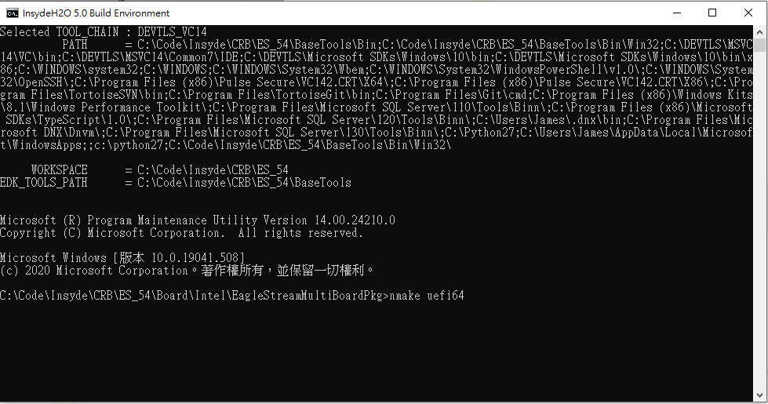
How to Compile
Generate the Binary
Double click ProjectBuild.bat
X64: Run “nmake uefi64” or “nmake efidebug”

Slide 12
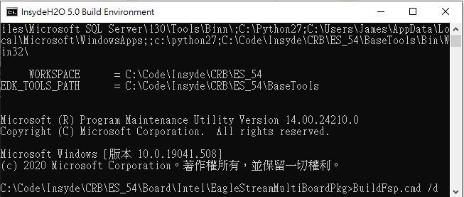

How to Compile FSP
Generate the Binary
Double click ProjectBuild.bat
X64:
Run “BuildFsp.cmd /d” or “BuildFsp.cmd /r” to generate the FSP binary
Run “nmake uefi64fsp” or “nmake efidebugfsp” to generate the full BIOS binary

Slide 13
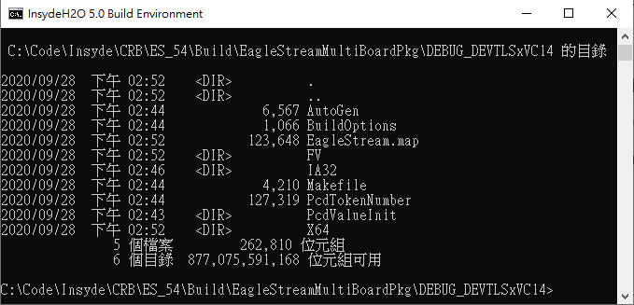
How to Compile
Build Result
If building successfully, it will generate the binary in
$(WORKSPACE)/Build/$(PROJECT_PKG)/$(BUILD_TARGET)_$(TOOL_CHAIN)/
FV: Subdirectory for the resultant firmware volumes
IA32: Location where the 32-bit output files (*.obj) are deposited
X64: Location where the 64-bit output files are deposited (For 64-bit platform)

Slide 14
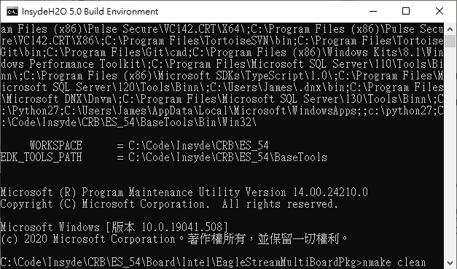
How to Compile
Cleaning Build Tips
The makefiles for all major build tips include a clean target that completely removes the binaries from previous builds.
Simply enter nmake clean into the build tip directory, corresponding to the prompt in a Command Prompt box.

Slide 15
PreBuild & PostBuild

Slide 16
PreBuild & PostBuild
ProjectPreBuild.bat
Commands before calling ChipsetPreBuild.bat
ProjectPreBuild.bat
ChipsetPreBuild.bat
Called by ProjectPreBuild.bat
ProjectPreBuild.bat
Commands after finishing ChipsetPreBuild.bat
Build modules/Generate FD

Slide 17
PreBuild & PostBuild
Build modules/Generate FD
ProjectPostBuild.bat
ProjectPostBuild.bat
Commands before calling ChipsetPostBuild.bat
ChipsetPostBuild.bat
Called by ProjectPostBuild.bat
ProjectPostBuild.bat
Commands after finishing ChipsetPostBuild.bat

Slide 18
Build Process

Slide 19
Build Process
Source Files
INF files
Platform
Makefile
DEC files
Build
Binary
Parsing
Tool
Module
Makefiles
DSC files
Auto-Gen
Files
FDF files
PE/COFF Binary
(.efi,.acpi,.com,
.aml,.bin) Files
Tools_def.txt
Target.txt
Build_rule.txt
Flash
Build Tool
Binary Files
Flash Image
.FD Files
Auto-Gen Stage
Make Stage
Image-Gen Stage

Slide 20
Meta-Data Files

Slide 21
Meta-Data Files – target.txt
target.txt: Defines the top level default configuration
Set the default build target configuration for the EDK2build tools
This configuration file sets up the following configurations
ACTIVE_PLATFORM → Platform DSC File
TARGET → RELEASE/DEBUG
TARGET_ARCH → IA32/X64/EBC/IPF/ARM
TOOL_CHAIN_CONF → Conf/tool_def.txt
TOOL_CHAIN_TAG → Tool Chain Tag Name
BUILD_RULE_CONF → Conf/build_rule.txt
MAX_CONCURRENT_THREAD_NUMBER

Slide 22
Meta-Data Files – target.txt
“target.txt” will be update during build process
BaseTools\Conf\Makefile
gen_release_target:
@echo ACTIVE_PLATFORM = Build/$(PROJECT_PKG)/Project.dsc > $(WORKSPACE)\Conf\target.txt
@echo TARGET_ARCH = $(ARCH) >> $(WORKSPACE)\Conf\target.txt
@echo TARGET = RELEASE >> $(WORKSPACE)\Conf\target.txt
@echo TOOL_CHAIN_CONF = Conf/tools_def.txt >> $(WORKSPACE)\Conf\target.txt
@echo TOOL_CHAIN_TAG = $(TOOL_CHAIN) >> $(WORKSPACE)\Conf\target.txt
@echo MAX_CONCURRENT_THREAD_NUMBER = $(NUMBER_OF_PROCESSORS) >> $(WORKSPACE)\Conf\target.txt
@echo BUILD_RULE_CONF = Conf/build_rule.txt >> $(WORKSPACE)\Conf\target.txt
gen_debug_target:
…

Slide 23
Meta-Data Files – tools_def.txt
Provide multiple tool chain support
Define the location of tool chains and tool flags
Each tool chain can have its own profile
TARGET_TOOLCHAIN_ARCH_COMMANDTYPE_ATTRIBUTE = <string>
RELEASE
DEBUG
VS2015
VS2017
UNIXGCC
DEVTLS
…
IA32
X64
IPF
ARM
…
CC
ASM
MAKE
VFRPP
ASLCC
…
FLAGS
PATH
FAMILY
DLL
…

Slide 24
Meta-Data Files – tools_def.txt
Record Statement Parsing Priority
TARGET_TOOLCHAIN_ARCH_COMMANDTYPE_ATTRIBUTE (Highest)
******_TOOLCHAIN_ARCH_COMMANDTYPE_ATTRIBUTE
TARGET_*********_ARCH_COMMANDTYPE_ATTRIBUTE
******_*********_ARCH_COMMANDTYPE_ATTRIBUTE
TARGET_TOOLCHAIN_****_COMMANDTYPE_ATTRIBUTE
******_TOOLCHAIN_****_COMMANDTYPE_ATTRIBUTE
TARGET_*********_****_COMMANDTYPE_ATTRIBUTE
******_*********_****_COMMANDTYPE_ATTRIBUTE
TARGET_TOOLCHAIN_ARCH_***********_ATTRIBUTE
******_TOOLCHAIN_ARCH_***********_ATTRIBUTE
TARGET_*********_ARCH_***********_ATTRIBUTE
******_*********_ARCH_***********_ATTRIBUTE
TARGET_TOOLCHAIN_****_***********_ATTRIBUTE
******_TOOLCHAIN_****_***********_ATTRIBUTE
TARGET_*********_****_***********_ATTRIBUTE
******_*********_****_***********_ATTRIBUTE (Lowest)

Slide 25
Meta-Data Files – build_rule.txt
Specifies how different format of files are processed
Provide build rules to create Makefile
## Syntax
# "[" <File-Type>[.<Build-Type>][.<Arch>][, <File-Type>[.<Build-Type>][.<Arch>]] "]" <EOL>
# <InputFile[.<ToolChainFamily>]> <EOL>
# (?|*).<File-Extension> [(\n|,) (?|*).<File-Extension>]
# <OutputFile[.<ToolChainFamily>]> <EOL>
# <FileFullPath>
# <ExtraDependency>
# <FileFullPath>
# <Command[.<ToolChainFamily>]> <EOL>
# <Command1>
# [<Command2>]

Slide 26
Thanks!

